Slide 1

VALLURUPALLI NAGESWARA RAO VIGNANA JYOTHI INSTITUTE OF ENGINEERING AND TECHNOLOGY
Department of Computer Science and Engineering
Non linear SVM and Kernels
MACHINE LEARNING
BTech CSE (III Year-II Sem)
Dr. Kriti Ohri
Assistant Professor
Department of Computer Science and Engineering

Slide 2
Non linear SVM and Kernels If the data is not linearly separable in the original, or input, space then we apply transformations to the data, which map the data from the original space into a higher dimensional feature space. The goal is that after the transformation to the higher dimensional space, the classes are now linearly separable in this higher dimensional feature space. We can then fit a decision boundary to separate the classes and make predictions. The decision boundary will be a hyperplane in this higher dimensional space.

Slide 3
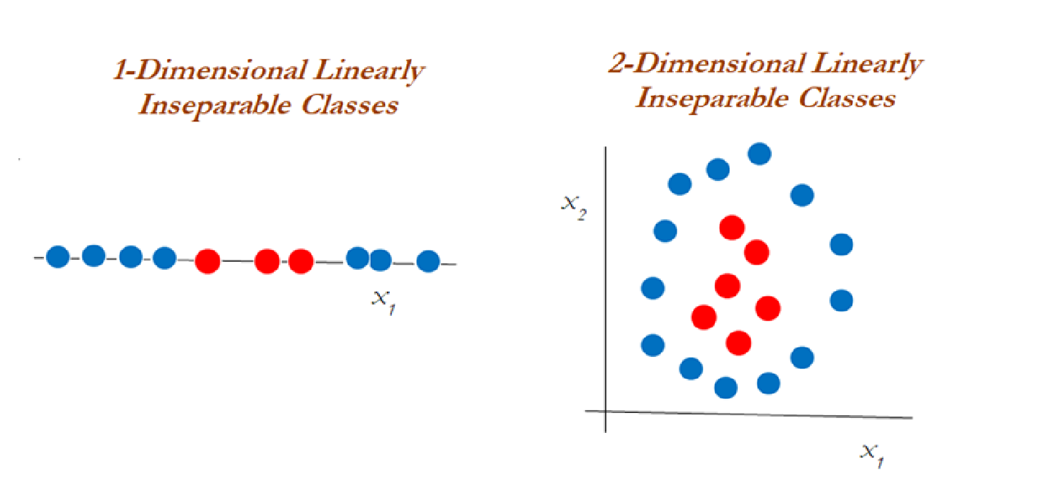
What if your data is not linearly separable
The support vector machine approach is considered during a non-linear decision and the data is not separable by a support vector classifier irrespective of the cost function.
The diagram illustrates the inseparable classes in a one-dimensional and two-dimensional space.

Slide 4
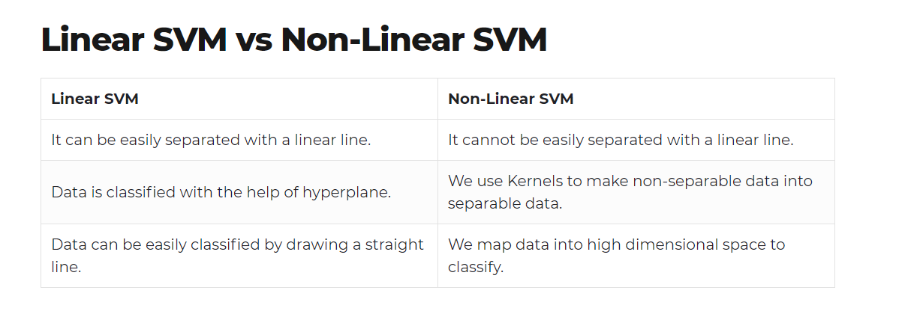

Slide 5
Types of SVMs
There are two different types of SVMs, each used for different things:
Simple SVM: Typically used for linear regression and classification problems.
Kernel SVM: Has more flexibility for non-linear data because you can add more features to fit a hyperplane instead of a two-dimensional space.

Slide 6
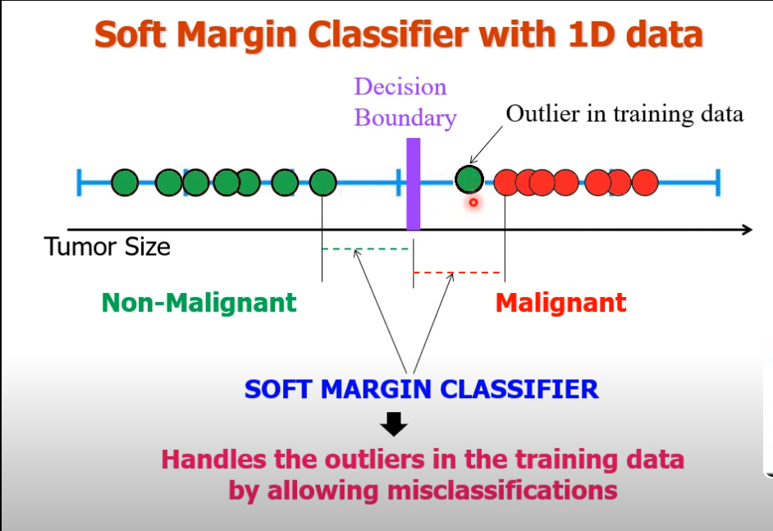

Slide 7
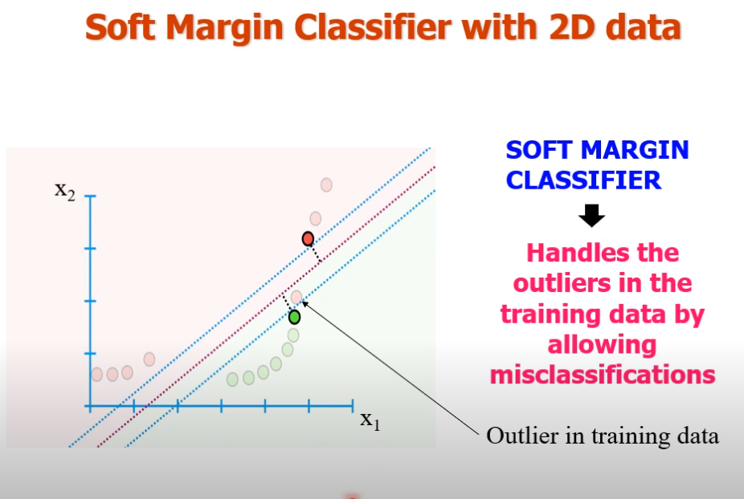

Slide 8
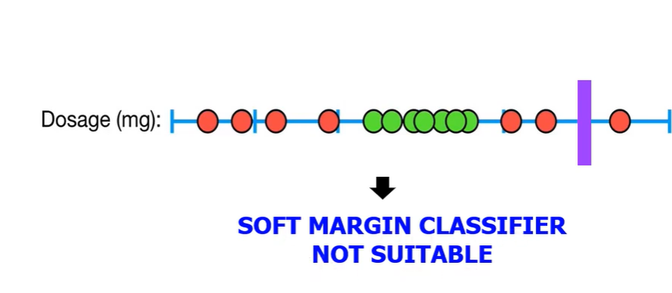
Dataset is not linearly separable, how to classify these observation.
The soft margin classifier is not suitable as wherever we have a hyperplane at any position , we will have many misclassification as soft margin can handle noise or outlier to some extent only.

Slide 9
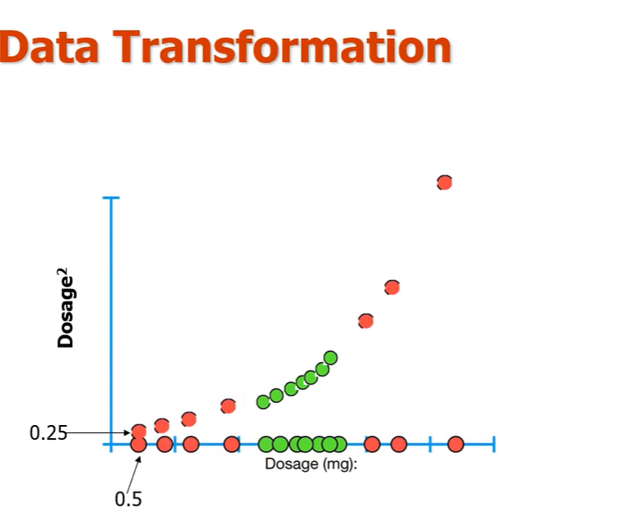

Slide 10
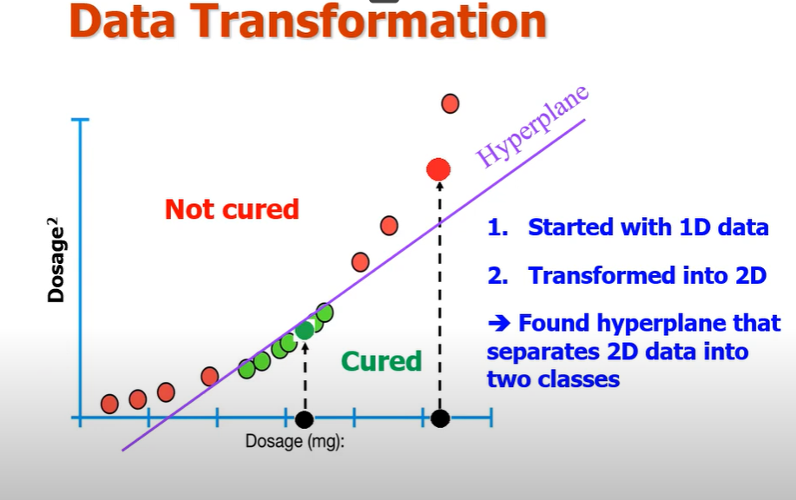

Slide 11
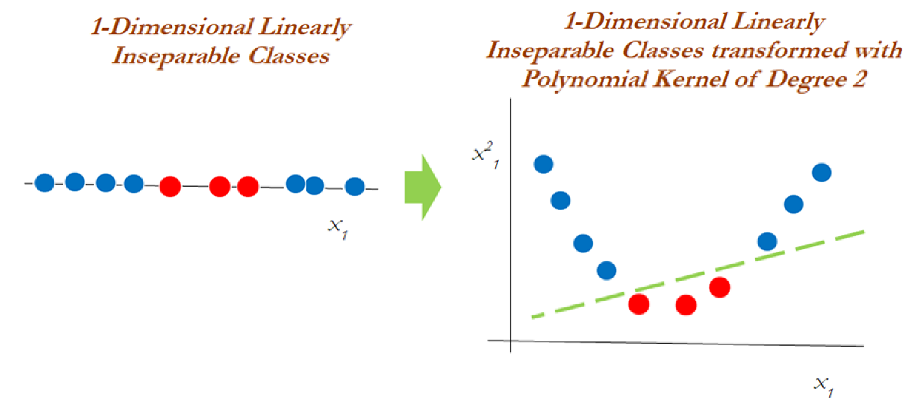
Kernel trick
When it is almost difficult to separate non-linear classes, we then apply another trick called kernel trick that helps handle the data.

Slide 12
It is obviously hard to visualize higher dimensional data, and so we first focus on some transformations applied to 1-dimensional data. In the example above , the picture on the left shows our original data points. In 1-dimension, this data is not linearly separable, but after applying the transformation ϕ(x) = x² and adding this second dimension to our feature space, the classes become linearly separable.

Slide 13
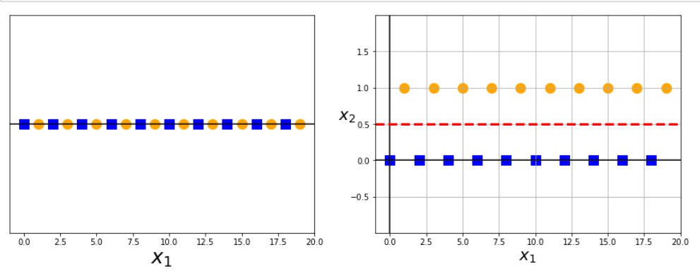
For now, we are just examining transformations of the original data to higher dimensions that allow the data to be linearly separated. These are just functions, and there are many possible functions that can map the data to any number of higher dimensions.
Here we apply the transformation ϕ(x) = x mod 2

Slide 14
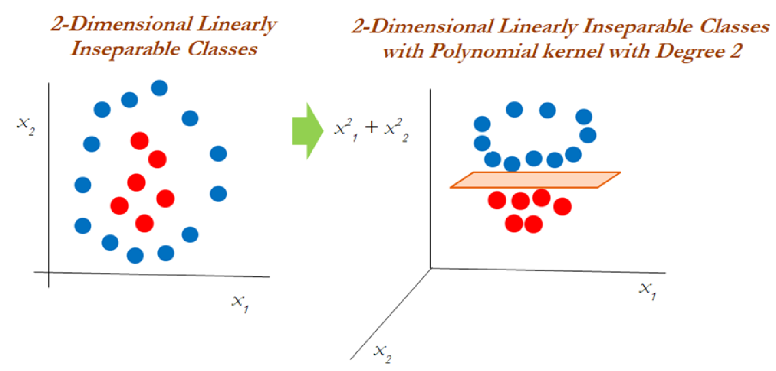
Now let us see how to handle the two-dimensional linearly inseparable data.
Now let us see how to handle the two-dimensional linearly inseparable data.
In two-dimensional data, the polynomial kernel of the second degree is applied by using a linear plane after transforming it to higher dimensions.

Slide 15
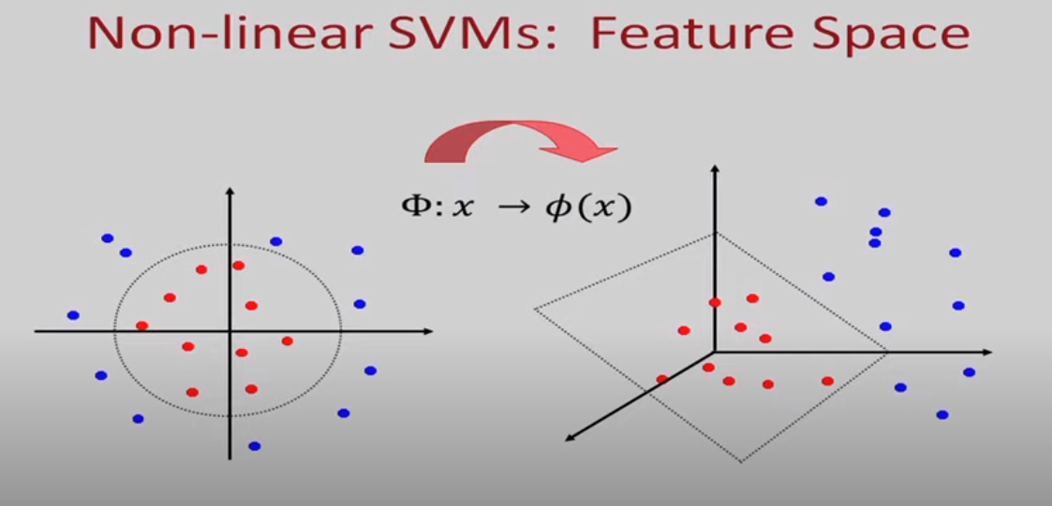

Slide 16
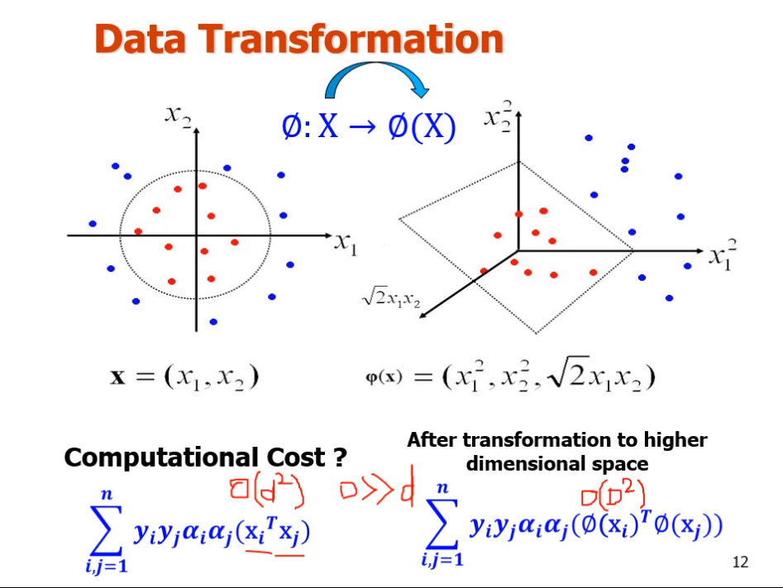
Notes:
Compute this pair wise. N training example, carry out computation n square times. And need to cal dot, product is expensive if dim incraeases

Slide 17
Transforming the data to high dimensional space and performing calculation is very costly.
But how to decide this transformation , in order to make this mathematically possible in a systematic manner we have concept called kernels to find support vectors in higher dimensional space.
Using kernel functions, it's possible to achieve this transformation without any major implication and computational cost.

Slide 18
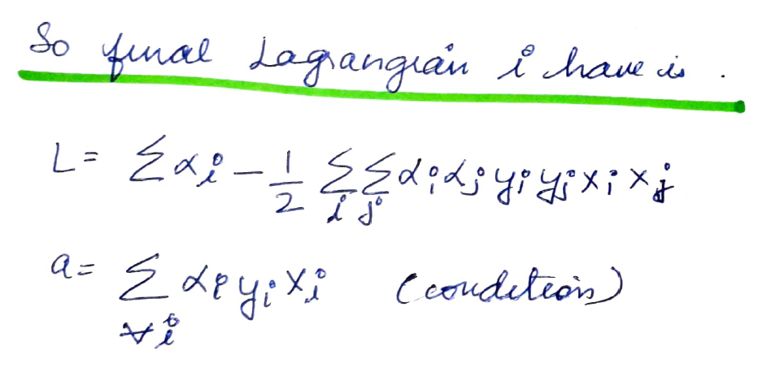
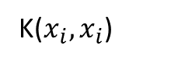
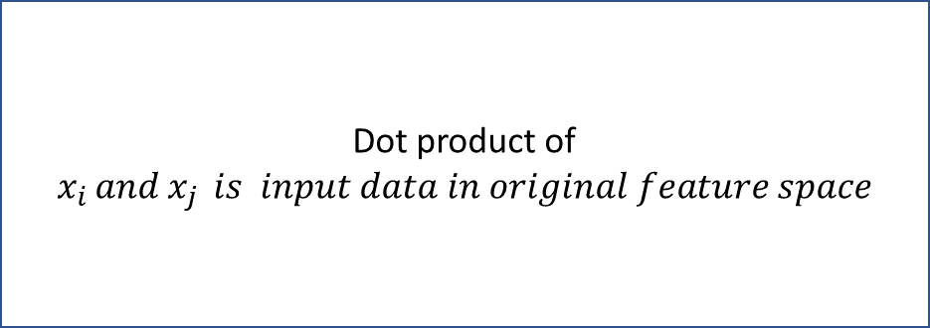
We know the Lagrangian is given by L, which is dual formulation
K($x_{i}, x_{i}$)
.
Dot product of $x_{i }and x_{j } is input data in original feature space$

Slide 19
Kernel trick
We have seen how higher dimensional transformations can allow us to separate data in order to make classification predictions. It seems that in order to train a support vector classifier and optimize our objective function, we would have to perform operations with the higher dimensional vectors in the transformed feature space. In real applications, there might be many features in the data and applying transformations that involve many polynomial combinations of these features will lead to extremely high and impractical computational costs.
The kernel trick provides a solution to this problem. The “trick” is that kernel methods represent the data only through a set of pairwise similarity comparisons between the original data observations x (with the original coordinates in the lower dimensional space), instead of explicitly applying the transformations ϕ(x) and representing the data by these transformed coordinates in the higher dimensional feature space.

Slide 20
SVM kernel functions
SVM algorithms use a set of mathematical functions that are defined as the kernel. The function of kernel is to take data as input and transform it into the required form. Different SVM algorithms use different types of kernel functions. These functions can be different types.

Slide 21
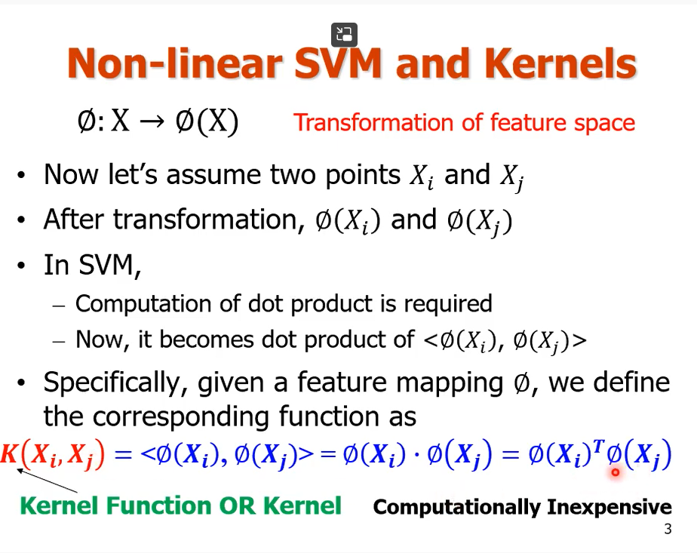
Transformed feature space
Original feature space

Slide 22
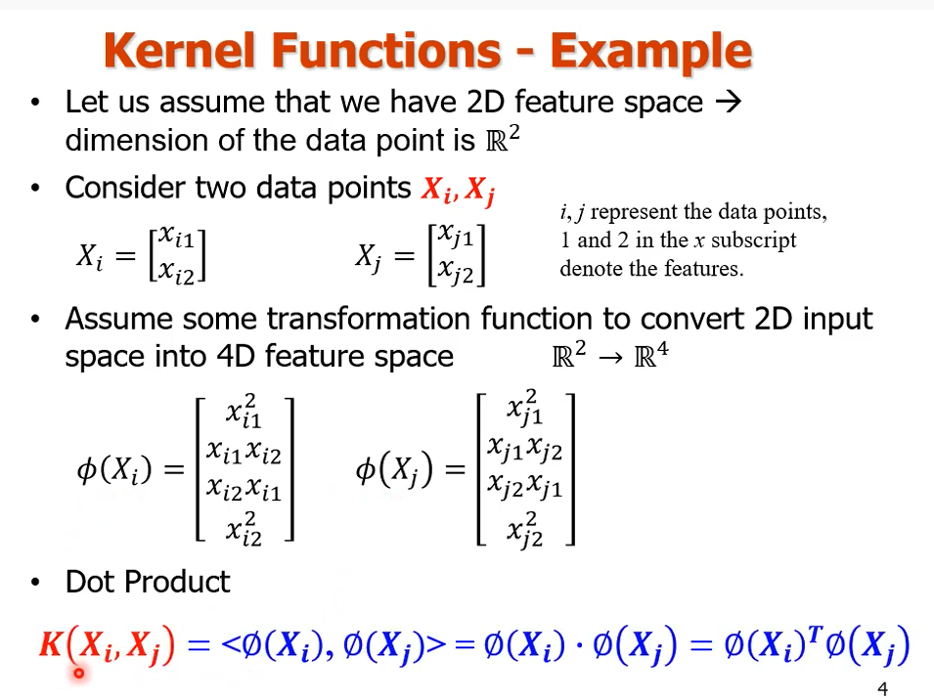

Slide 23
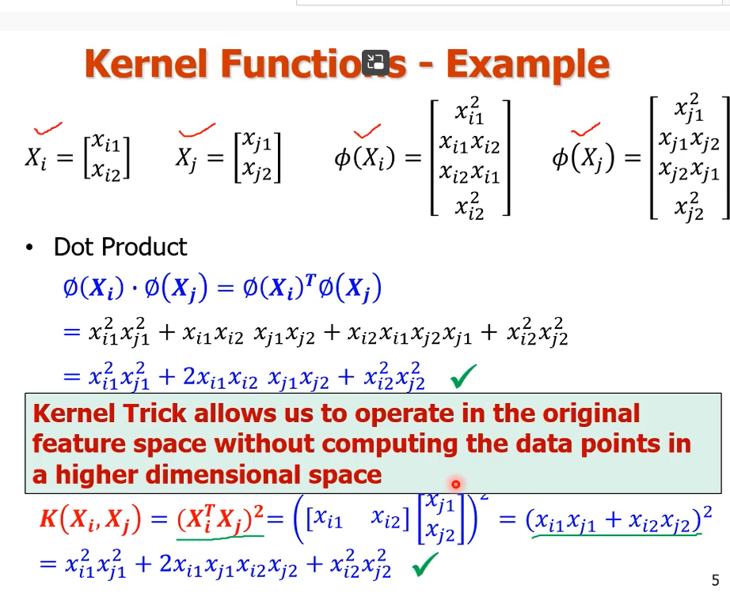

Slide 24
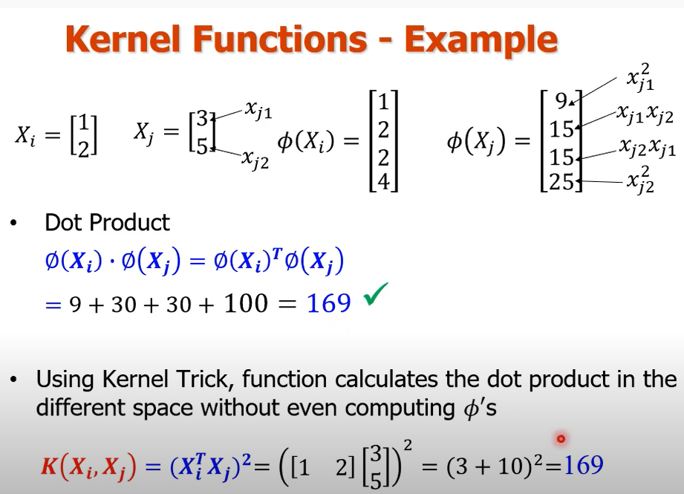

Slide 25
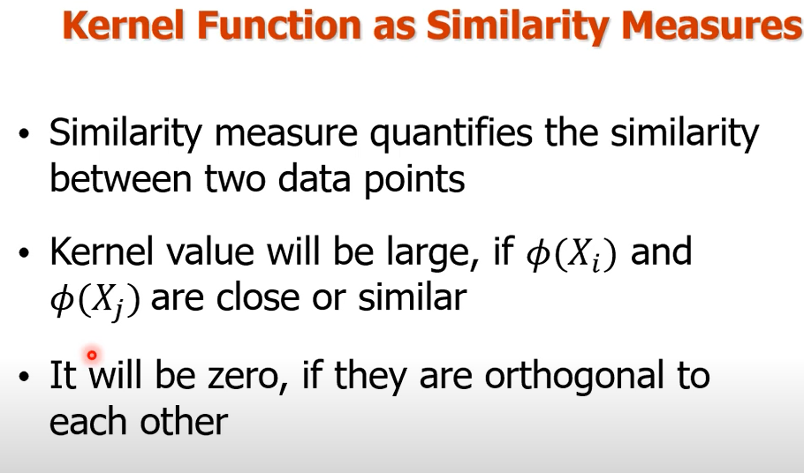

Slide 26
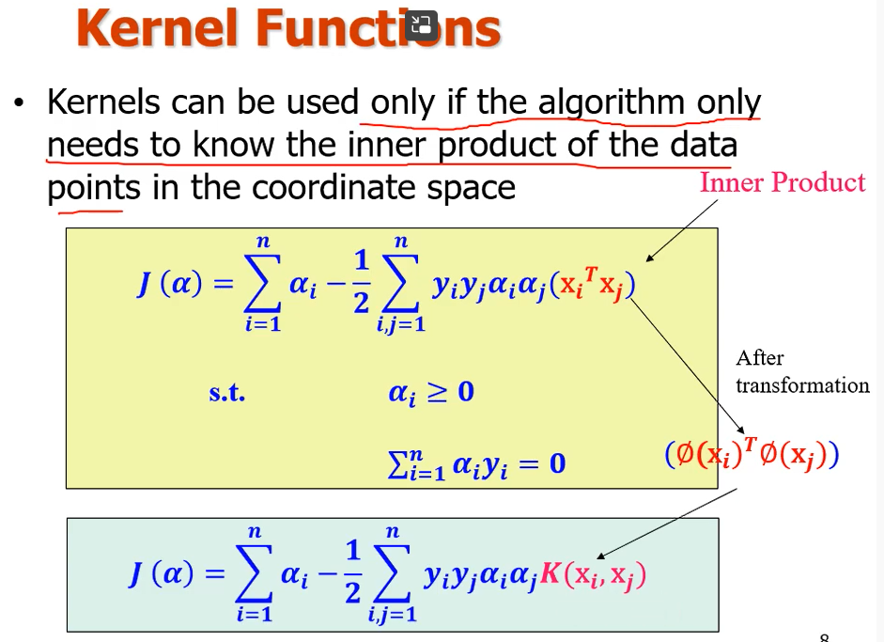
Kernel function

Slide 27
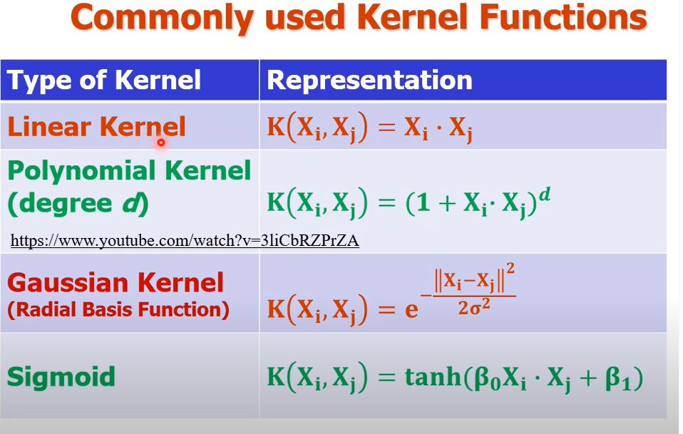

Slide 28
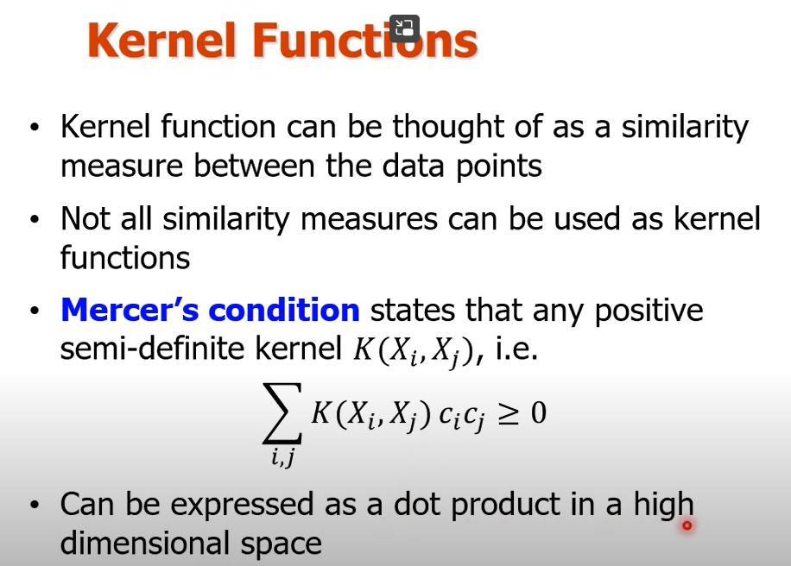
Notes:
Similarity between points as a matrix, and this matrix is positive , symmetric and semidefinite then a kernel function will exist.

Slide 29
A semi-definite kernel function in SVM is one that produces a positive semi-definite kernel matrix, meaning the matrix has non-negative eigenvalues. This property is crucial for the kernel function to be valid for use in SVM and other machine learning methods, as it guarantees the feasibility and stability of the optimization process.

Slide 30
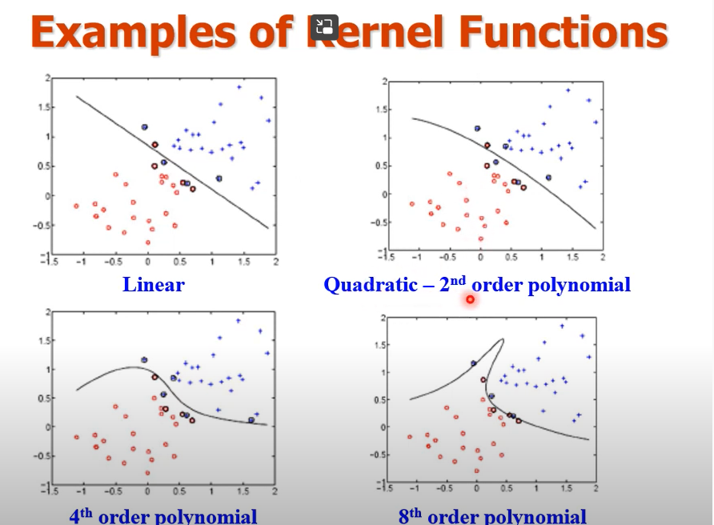

Slide 31
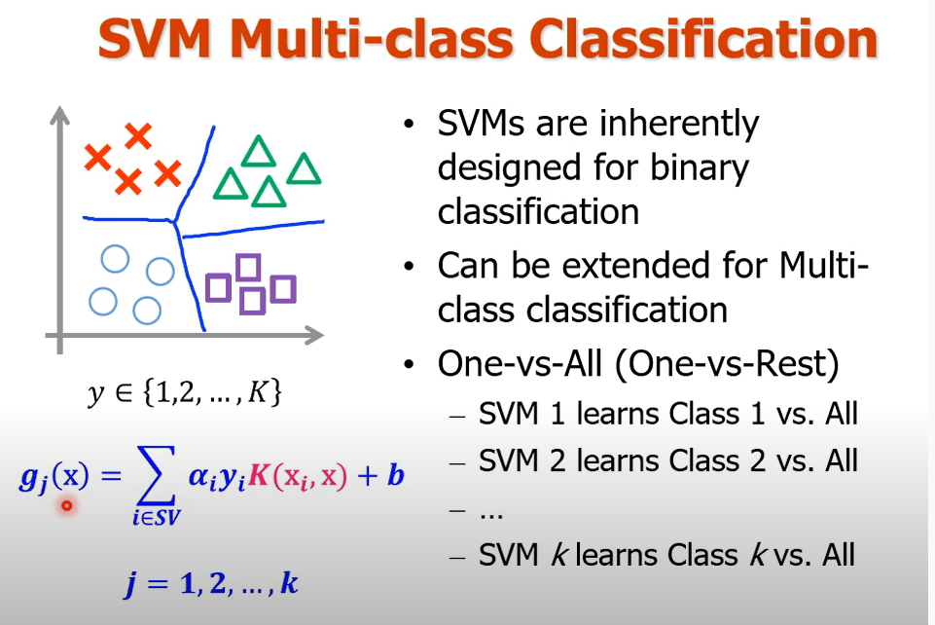

Slide 32
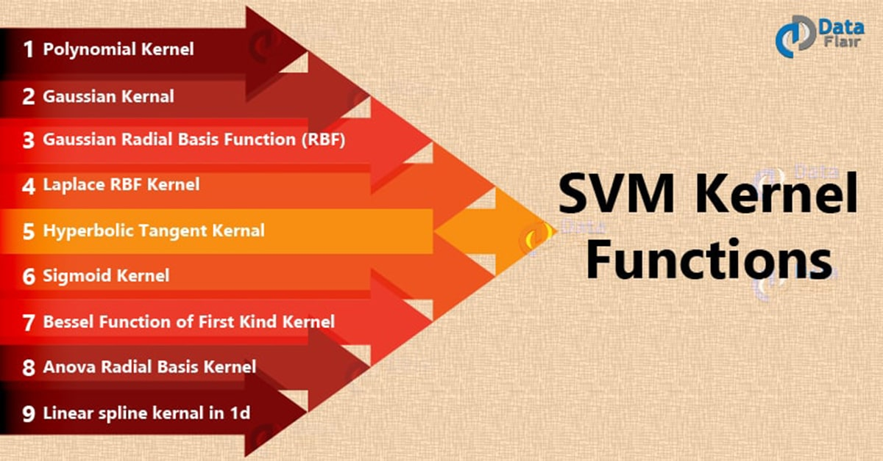
Different types of kernel functions

Slide 33
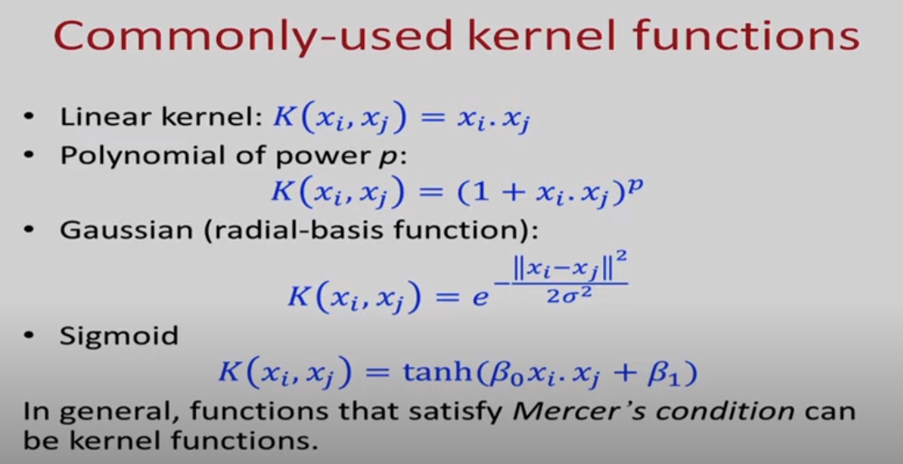
Remember the Kernel functions

Slide 34
Linear Kernel functions
These are commonly recommended for text classification because most of these types of classification problems are linearly separable.
The linear kernel works really well when there are a lot of features, and text classification problems have a lot of features. Linear kernel functions are faster than most of the others and you have fewer parameters to optimize.
Here's the function that defines the linear kernel:
f(X) = w^T * X + b
In this equation, w is the weight vector that you want to minimize, X is the data that you're trying to classify, and b is the linear coefficient estimated from the training data. This equation defines the decision boundary that the SVM returns.

Slide 35
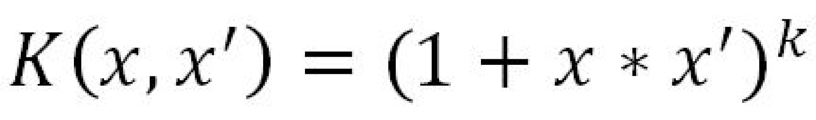
Polynomial Kernel-
A polynomial function is used with a degree 2 to separate the non-linear data by transforming them into higher dimensions. Take a look at the following equation:

Slide 36
Radial Basis Function (RBF) Kernel
RBF kernels are the most generalized form of kernelization and is one of the most widely used kernels due to its similarity to the Gaussian distribution. The RBF kernel function for two points X₁ and X₂ computes the similarity or how close they are to each other.

Slide 37
What is Ockham's Razor
Ockham's Razor encourages:
Maximizing the margin for simplicity and generalizability.
Choosing simpler kernel functions unless a more complex one is necessary.
Regularizing the model with an optimal C to balance complexity and accuracy.
By following these principles, SVM models can achieve good generalization performance on new data without becoming overly complex. This adherence to simplicity aligns with the philosophy of Ockham's Razor in machine learning and statistical modeling.

Slide 38
References
https://www.youtube.com/watch?v=HwZKG8-UJfs

